Slide 1
XLNet: Generalized Autoregressive Pretraining
for Language Understanding
Written By: Zhilin Yang, Zihang Dai, Yiming Yang, Jaime Carbonell, Ruslan Salakhutdinov, Quoc V. Le
Presented By: Mica Haney

Slide 2


Autoregression
A model structure that estimate the probability distribution of a text corpus. At each location in a text sequence, the model uses all of the previous or all of the following tokens to calculate a product that is the probability of the target token.
The drawback is that autoregressive models are not bi-directional.

Slide 3
Autoencoding
A type of bidirectional model that attempts to reconstruct the input. Typically in NLP, this is done with masked language modeling (MLM) to generate the encodings. One of the most famous in NLP is BERT.
A pretrain-finetune discrepancy exists because it is assumed that masked input tokens are independent of each other as long as the unmasked tokens are present.
The drawbacks are that the artificial symbols never appear in real-world data, and that autoencoders cannot model joint probabilities.

Slide 4
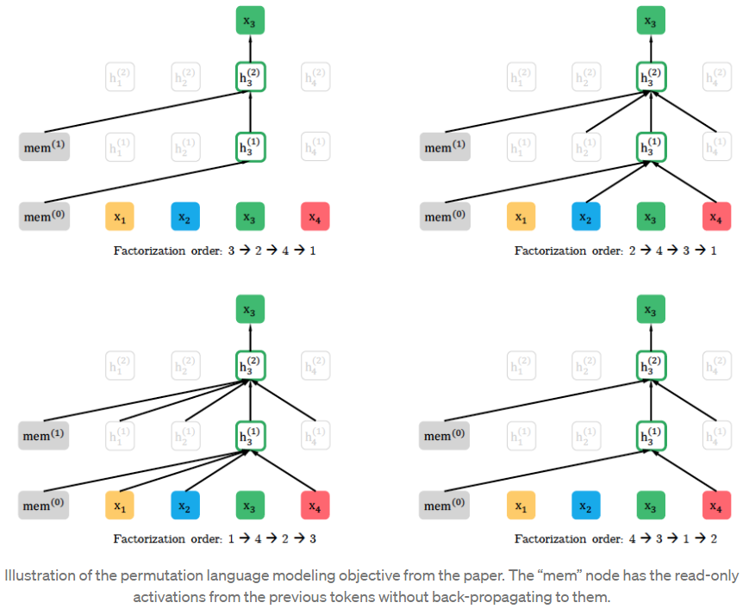
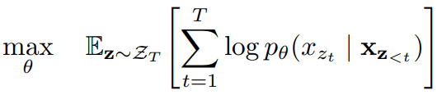
Permutation Modeling
For predicting xn in a series of N tokens, find the N! permutations of the input. In each factorization ordering, take the t-1 preceding tokens and feed forward to predict token at t. The rearrangement of tokens captures any bi-directional information. The goal is to maximize the expected log-likelihood of the sequence.

Slide 5
Permutation LM vs Transformers
Transformers cannot predict x based only on the position of x, rather than its contents. Transformers cannot predict x with all of the contents of the previous tokens encoded.
The position information is inseparable from the token embedding in a Transformer. Given the change of position in permutation LM, this is a problem. It produces the same predictions even after shuffling.

Slide 6
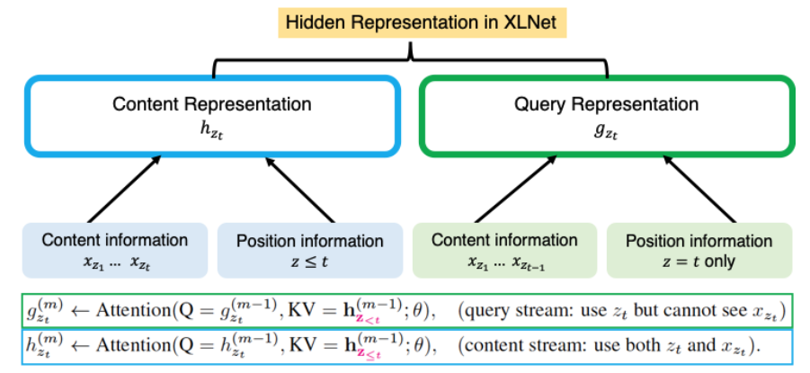
Two-Stream Self-Attention
To solve the two issues, two attention streams are used. The first - content - is the same as the standard self-attention, and contains both content and position information. The second - query - contains only position information and effectively replaces MLM in BERT. This has the effect of also avoiding limitations introduced by MLM’s data corruption.
During fine-tuning, the query stream can be dropped as the content stream is identical to the standard self-attention.

Slide 7
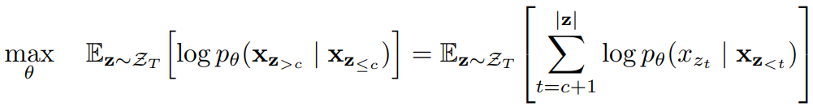
Partial Prediction
Permutation language modeling is notably more challenging to optimize. Convergence is slow. To speed this up, only the last tokens are predicted using a factorization order.
Split z into non-target z_{<=c} and target z_{>c}, where c is the cutting point. Hyperparameter K is used such that about 1/K tokens are selected for prediction.

Slide 8

Incorporating Ideas from Transformer-XL
The relative positional encoding scheme and the segment recurrence mechanism are incorporated with Transformer-XL. The positional encoding is straightforward and discussed earlier.
For the segment recurrence mechanism, suppose there are two segments taken from a sequence x₁ = s_{1:T} and x₂ = s_{T+1:2T}. Let z₁ and z₂ be permutations bfo [1 … T] and [T+1 … 2T] respectively. Based on permutation z₁, process the first segment and get the content representation h^{~(m)} for each layer m. For the next segment x₂, the attention update is:
Where [. , .] is a concatenation.

Slide 9
Modeling Multiple Segments
This is for target tasks that require more than one separated sequences. As in BERT, sample two segments and concatenate them then perform permutation language modeling. Only memory in the same context is used.
Follows BERT’s standards: [CLS, A, SEP, B, SEP]
Additionally, the embedded position is relative to other tokens. Unlike in BERT, the model looks at if two tokens are in the same segment instead of which specific segment(s) the tokens are from.

Slide 10
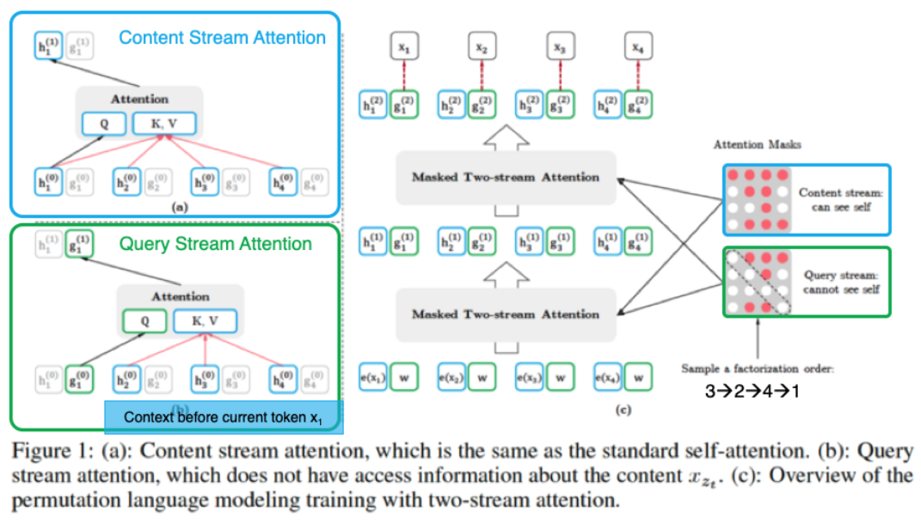
Architecture Diagram

Slide 11
Training
Use BooksCorpus, English Wikipedia, Giga5, ClueWEb, and Common Crawl for pre-training. Total of 158 GB of text. After tokenization, results in 32.89B subword pieces.
A bidirectional input pipeline feeds each of the forward and backwards pipelines half a batch.

Slide 12
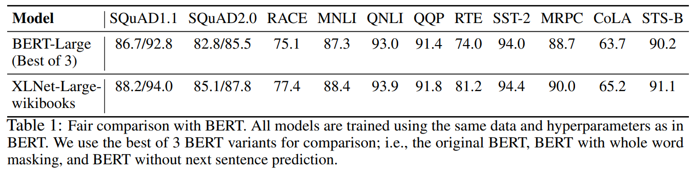
Results: Fair Comparison with BERT

Slide 13
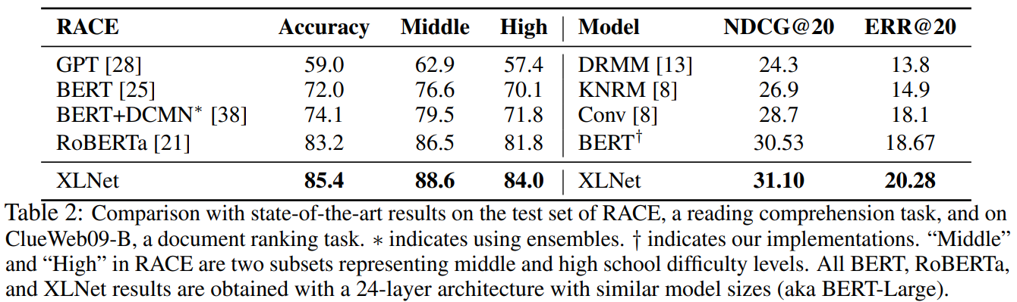
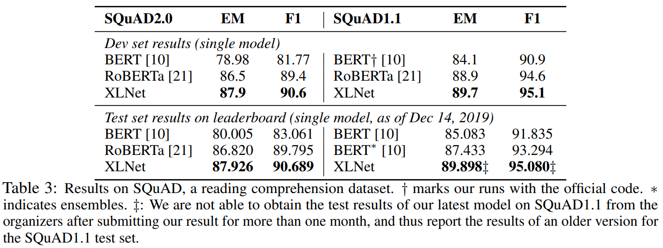
Results: Comparison with RoBERTa

Slide 14
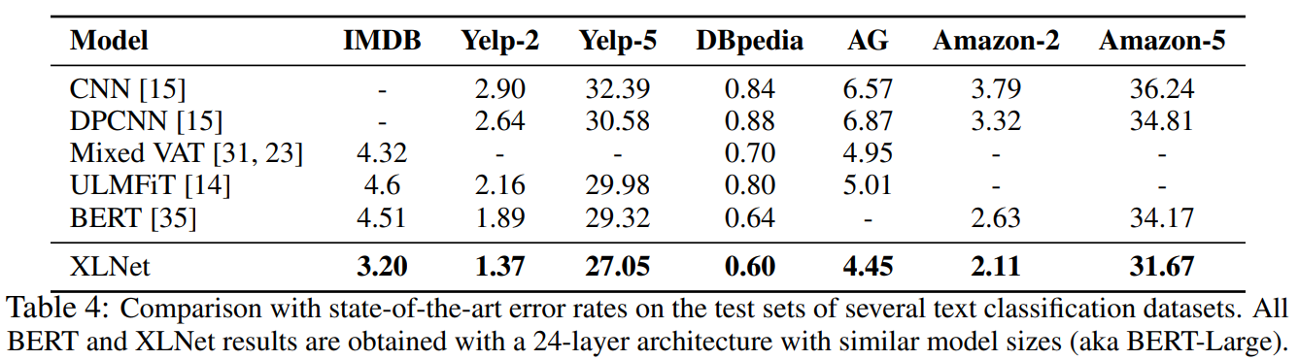
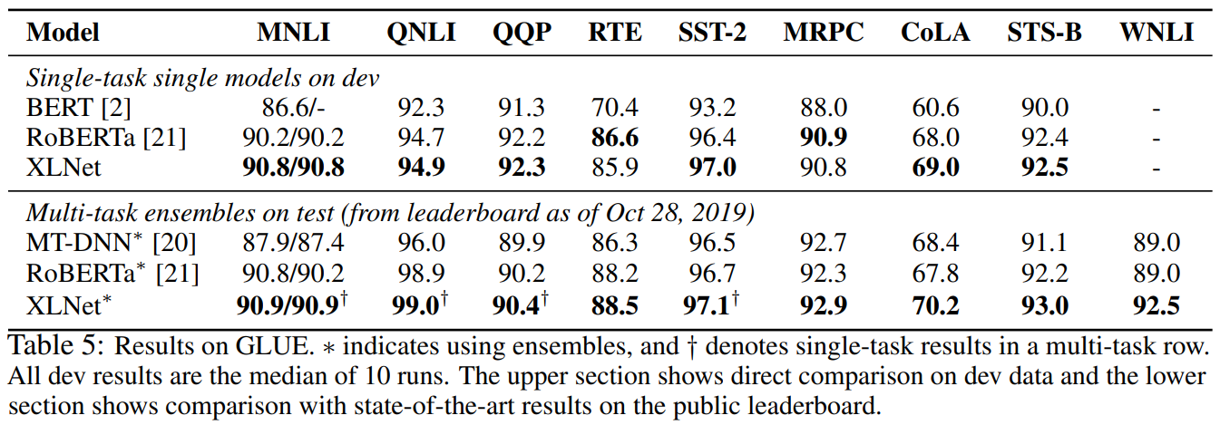
Results: Comparison with RoBERTa

Slide 15
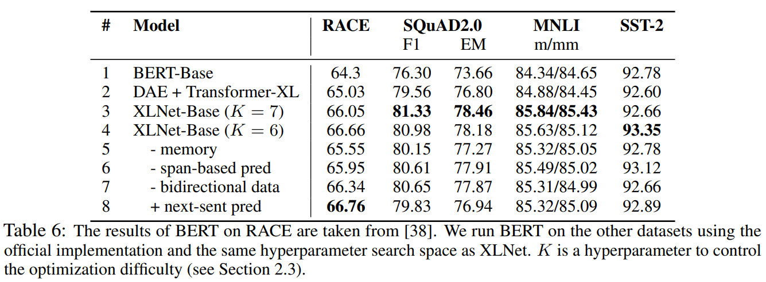
Ablation Study

Slide 16
References
XLNet Paper: https://arxiv.org/pdf/1906.08237.pdf
Understanding XLNet: https://medium.com/@zxiao2015/understanding-language-using-xlnet-with-autoregressive-pre-training-9c86e5bea443

